Slide 1
Software Requirement Specification (SRS)

Slide 2
Outline
Introduction
The goal of SRS
Why SRS document is important
SRS document elements
Characteristics of a good SRS
SRS document
Steps to write SRS document
What should a typical SRS document include
Tools for SRS documents
Use case diagram
User story
Workflow
Wireframe
Logical data model
Data dictionary

Slide 3
Introduction
A software requirements specification (SRS) is a comprehensive description of the intended purpose and environment for software under development. The SRS fully describes what the software will do and how it will be expected to perform.
An SRS is a software development roadmap that provides designers, testers, clients and end-users with metrics, use case scenarios, and other details of the future product. Briefly saying, it collects the clients’ demands and explanations of the development team, how these demands will come to life in custom software development services.

Slide 4
The goals of SRS
Provide feedback to the customer, ensuring that the IT company understands the issues the software system should solve and how to address those issues.
Help to break a problem down into smaller components just by writing down the requirements.
Speed up the testing and validation processes.
Facilitate reviews.

Slide 6
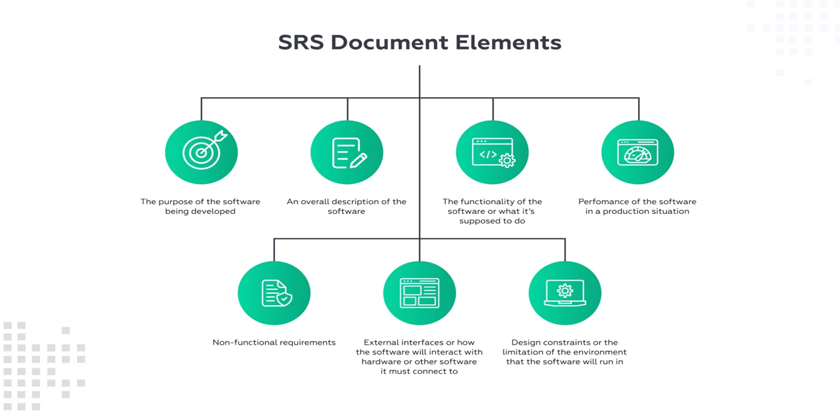

Slide 7
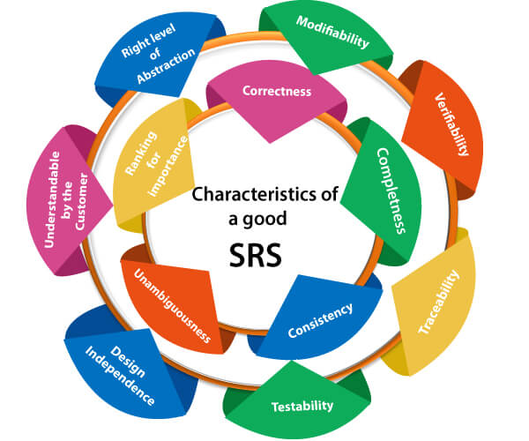
Characteristics of good SRS

Slide 8
Characteristics of good SRS (cont’d)
Correctness: User review is used to ensure the correctness of requirements stated in the SRS. SRS is said to be correct if it covers all the requirements that are actually expected from the system.
Completeness: Completeness of SRS indicates every sense of completion including the numbering of all the pages, resolving the to be determined parts to as much extent as possible as well as covering all the functional and non-functional requirements properly.
Consistency: Requirements in SRS are said to be consistent if there are no conflicts between any set of requirements. Examples of conflict include differences in terminologies used at separate places, logical conflicts like time period of report generation, etc.

Slide 9
Characteristics of good SRS (cont’d)
Unambiguousness: SRS is said to be unambiguous if all the requirements stated have only 1 interpretation. Some of the ways to prevent unambiguousness include the use of modelling techniques like ER diagrams, proper reviews and buddy checks, etc.
Ranking for importance and stability: There should a criterion to classify the requirements as less or more important or more specifically as desirable or essential. An identifier mark can be used with every requirement to indicate its rank or stability.

Slide 10
Characteristics of good SRS (cont’d)
Modifiability: SRS should be made as modifiable as possible and should be capable of easily accepting changes to the system to some extent. Modifications should be properly indexed and cross-referenced.
Verifiability: SRS is verifiable if there exists a specific technique to quantifiably measure the extent to which every requirement is met by the system. For example, a requirement starting that the system must be user-friendly is not verifiable and listing such requirements should be avoided.
Traceability: One should be able to trace a requirement to design component and then to code segment in the program. Similarly, one should be able to trace a requirement to the corresponding test cases.

Slide 11
Characteristics of good SRS (cont’d)
Design Independence: There should be an option to choose from multiple design alternatives for the final system. More specifically, the SRS should not include any implementation details.
Testability: SRS should be written in such a way that it is easy to generate test cases and test plans from the document.
Understandable by the customer: An end user maybe an expert in his/her specific domain but might not be an expert in computer science. Hence, the use of formal notations and symbols should be avoided to as much extent as possible. The language should be kept easy and clear.
Right level of abstraction: If the SRS is written for the requirements phase, the details should be explained explicitly. Whereas, for a feasibility study, fewer details can be used. Hence, the level of abstraction varies according to the purpose of the SRS.

Slide 12

SRS document
Once you have gathered all requirement of a project you are ready to begin writing the SRS document that describes what the software will do and how it will be expected to perform. It also describes the functionality the product needs to fulfil all stakeholders (business, users) needs.
The two main participants in the SRS creation process are the contractor and the customer. The customer usually takes the most responsibility for the documentation. Sometimes, a customer has no idea exactly how the project must look. In other cases, he has too many ideas. In either case, cooperation with the contractor will help you to understand exactly what is needed and create the proper documentation.

Slide 13

SRS document (cont’d)
The characteristics of good SRS document are:
Clearness. A good SRS document template should be understandable. Ensure your product's software requirements are clear and easy to read, to avoid misunderstandings with the stakeholders.
Correctness. It’s important to ensure your software requirements documentation is correct and consistent with the expected system requirements.
Completeness. The SRS document example needs to provide enough details for software development to take place.
Flexibility. Your SRS documentation should be flexible enough to allow the updating of various sections.
Consistency. Make sure your software requirements all fit together without any conflicts. The document should also have a consistent format and use the same terminology throughout.

Slide 14
Steps to write good SRS document
Step 1: Build an Outline
The software requirements specification must have a clear and understandable structure. A good outline is crucial to the whole software development process. It helps avoid wasting developers’ time and effort reading unnecessary information. Furthermore, it minimizes the risk of excluding valuable data from the process.
Step 2: Determine the Project Goal
identify your project's purposes using the following process:
1- Clarify your product's scope.
2- Illustrate its value to consumers.
3- Specify the target audience for the product.
4- Showcase all the product's advantages.

Slide 15
Steps to write good SRS document
Step 3: Write an Overview of Your Future Project
In this stage, you will need to give an in-depth description of the project you're ultimately going to create. Mention all functions and features of the software and define how they will fit users' needs and expectations.
Step 4: Detail Your Functional and Non-Functional Requirements
After writing the general description of your software, it is time to define its specific requirements. Outlining the various types of requirements in software engineering functional requirements and non-functional requirement.
Step 5: Get Stakeholders Approval for the SRS Document
approval is a much-anticipated part of development. However, client’s edits can sometimes negate the whole amount of work, completed at a certain point in the project. To avoid the pressure, we recommend agreeing to small parts of completed SRS documentation, rather than submitting a whole package of at once. This helps to fix certain issues quickly and is less troublesome.

Slide 16
What should a Typical SRS Document Include
Introduction
Purpose
Intended Audience
The structure of the SRS document begins with an introduction. This section illustrates the overall software requirements along with their scope for your team.
It includes the types of requirements described in the document and a list of the people who will work with it. A few paragraphs will be enough to discuss the goals of your SRS documentation.
List all the team members and stakeholders who will take part in the SRS document creation and those who will have access to the completed document. Describe their roles to identify each one's responsibilities within the project.

Slide 17
What should a Typical SRS Document Include (cont’d)
Intended Use
Scope
Definitions and Acronyms
Identify the cases in which your team will use the software requirements specification:
This subsection provides a brief representation of the system. You can describe the project from a more technical angle, mentioning its functionality and positioning.
Describe all specific terms mentioned in the requirements documentation in software engineering, to avoid misunderstandings with new developers. Name business entities and stakeholders with a particular abbreviation to speed up the process of SRS creation.
- estimating costs and project duration
- possible risks evaluation
- monitoring the team’s success within the project
- dealing with conflicting situations
Illustrate the users that are expected to interact with the system. Explain why this software development solution is unique. Thus, you will be able to interest stakeholders and gain more investments in your project.
- determining new functions through brainstorming

Slide 18
Tools for SRS Documentation
Use Case Diagram : represent the dynamic behaviour of a system. It encapsulates the system's functionality by incorporating use cases, actors, and their relationships. It models the tasks, services, and functions required by a system/subsystem of an application. It depicts the high-level functionality of a system and also tells how the user handles a system.

Slide 19
Tools for SRS Documentation (cont’d)
User story: is a requirement expressed from the perspective of an end-user goal. User Stories may also be referred to as Epics, Themes or features but all follow the same format.
A User Story is really just a well-expressed requirement.
The User Story format has become the most popular way of expressing requirements in Agile for a number of reasons:
- It focuses on the viewpoint of a role who will use or be impacted by the solution
- It defines the requirement in language that has meaning for that role
- It helps to clarify the true reason for the requirement
- It helps to define high level requirements without necessarily going into low level detail too early
User Stories are often deemed to comprise three elements - the 3C’s
- Card
- Conversation
- Confirmation

Slide 20
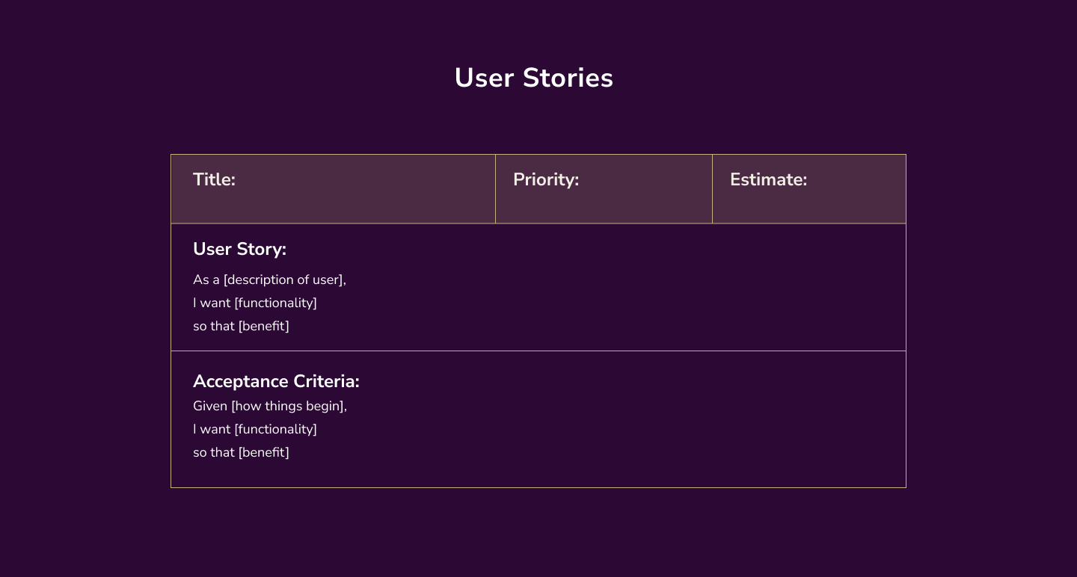

Slide 21
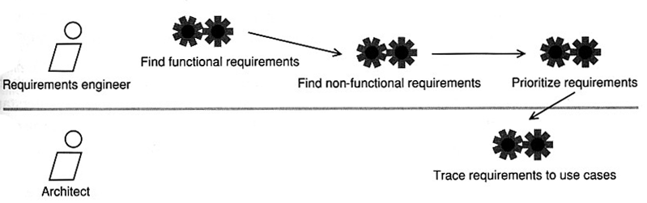
Tools for SRS Documentation (cont’d)
Workflow: series of activities shows us the workers and activities involved in a particular workflow. A workflow specifies the component tasks and related roles of a specific workflow.

Slide 22
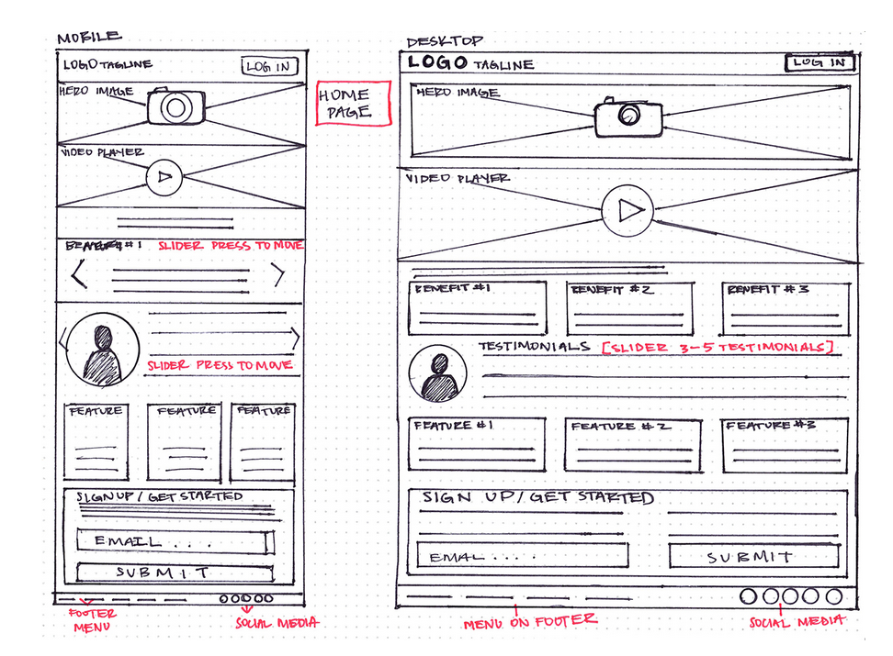
Tools for SRS Documentation (cont’d)
Wireframe: tends to be more sketch-like and not have as much visual detail. Their job is to help visually describe functionality without getting bogged down on stylistic choices. it helps understanding of the project requirements and thus eliminate confusions and vagueness early on

Slide 23
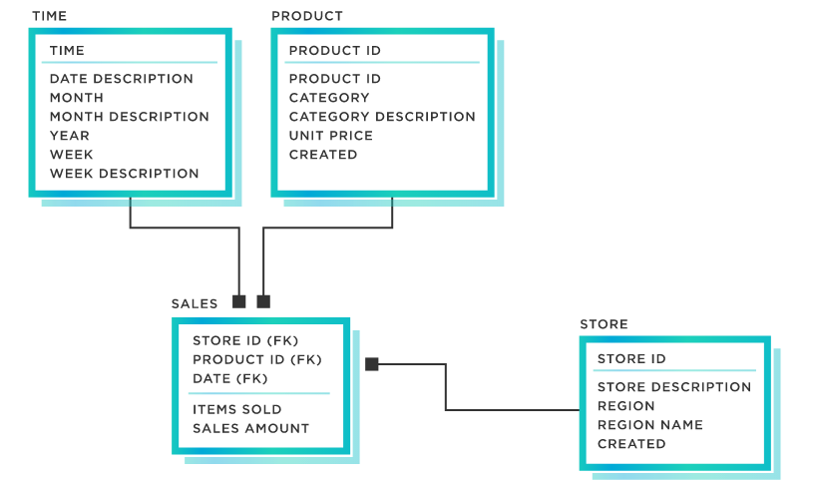
Tools for SRS Documentation (cont’d)
Logical Data Model: It serves to define how a system has to be implemented regardless of the database management system being used. Data architects and business analysts are usually the creators of a logical data model. The goal of creating a logical data model is to develop a highly technical map of underlying rules and data structures.

Slide 24
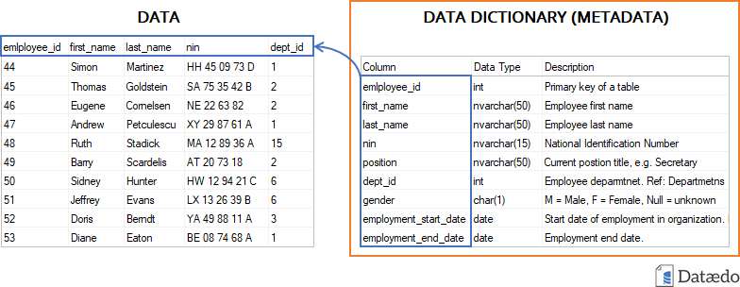
Tools for SRS Documentation (cont’d)
Data dictionary: is a file or a set of files that contain information about objects in the database. It’s basically a repository of data names, definitions, and attributes used to describe the data. We can say its data about data.

Slide 25
References
Requirements Engineering: From System Goals to UML Models to Software Specifications
https://docode.dev/software-requirement-specification-guide/
https://www.techtarget.com/searchsoftwarequality/definition/software-requirements-specification
https://www.techtarget.com/searchsoftwarequality/definition/software-requirements-specification
https://www.javatpoint.com/software-requirement-specifications
https://impressit.io/blog/software-requirements-specification-guide
https://www.uptech.team/blog/srs-document
https://www.tibco.com/reference-center/what-is-a-logical-data-model

